Slide 1
Numerical methods for Solving wave equation
Prepared By: Ramiz Mahmmud
ID: 18203035
MS Session: 2021-2022

Slide 2
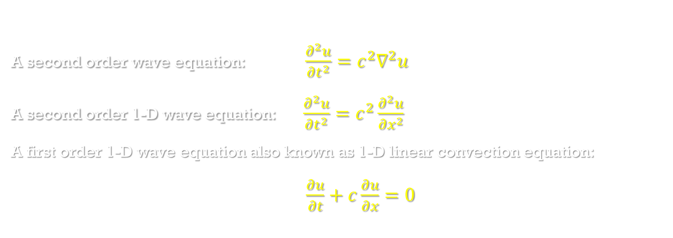
Introduction to wave equation
A second order wave equation: $\frac{∂^{2}u}{∂t^{2}}=c^{2}∇^{2}u$
A second order 1-D wave equation: $\frac{∂^{2}u}{∂t^{2}}=c^{2}\frac{∂^{2}u}{∂x^{2}}$
A first order 1-D wave equation also known as 1-D linear convection equation:
$\frac{∂u}{∂t}+c\frac{∂u}{∂x}=0$

Slide 3
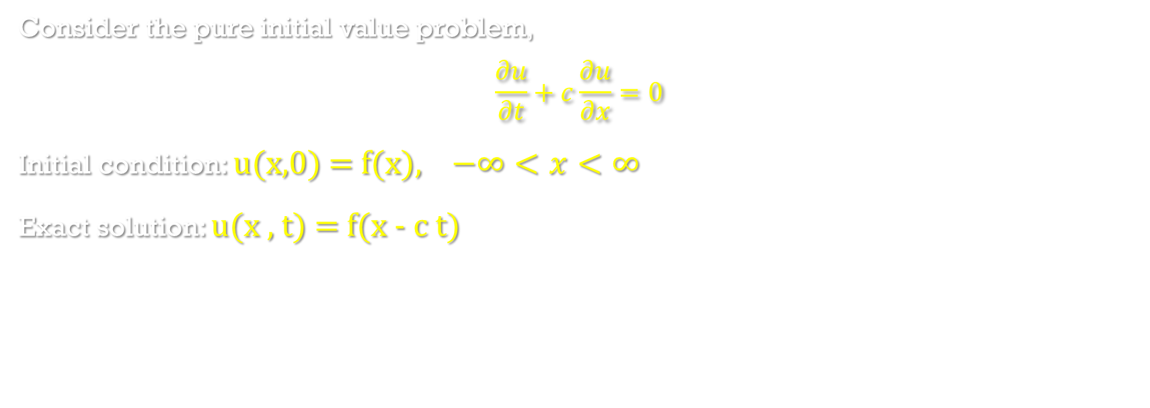
Solution of convection equation
Consider the pure initial value problem,
$$\frac{∂u}{∂t}+c\frac{∂u}{∂x}=0$$
Initial condition: u(x,0) = f(x), $−∞<x<∞$
Exact solution: u(x , t) = f(x - c t)

Slide 4
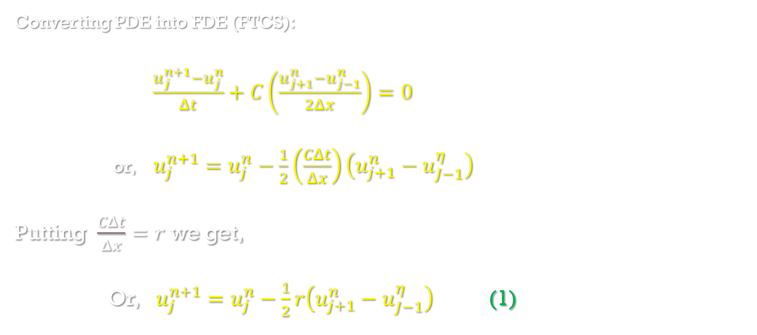
Euler explicit method
Converting PDE into FDE (FTCS):
$\frac{u_{j}^{n+1}−u_{j}^{n}}{Δt}+C\left(\frac{u_{j+1}^{n}−u_{j−1}^{n}}{2Δx}\right)=0$
or, $u_{j}^{n+1}=u_{j}^{n}−\frac{1}{2}\left(\frac{CΔt}{Δx}\right)\left(u_{j+1}^{n}−u_{J−1}^{η}\right)$
Putting $\frac{CΔt}{Δx}=r$ we get,
Or, $u_{j}^{n+1}=u_{j}^{n}−\frac{1}{2}r\left(u_{j+1}^{n}−u_{J−1}^{η}\right)$ (1)

Slide 5
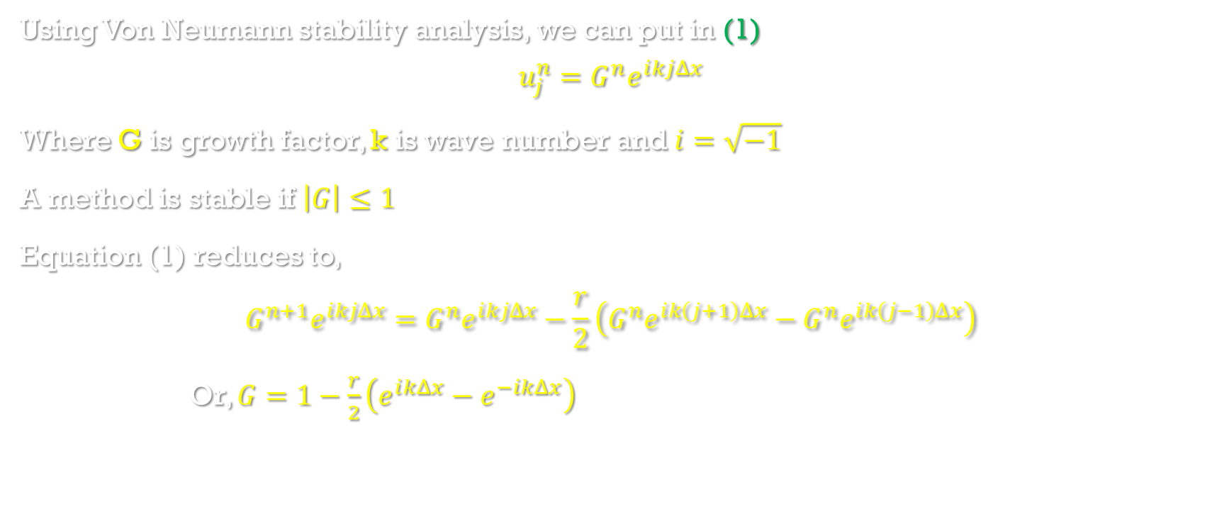
Von Neumann stability analysis of Euler explicit method
Using Von Neumann stability analysis, we can put in (1)
$$u_{j}^{n}=G^{n}ⅇ^{ⅈkjΔx}$$
Where G is growth factor, k is wave number and $ⅈ=\sqrt{−1}$
A method is stable if $\left|G\right|≤1$
Equation (1) reduces to,
$$G^{n+1}ⅇ^{ⅈkjΔx}=G^{n}ⅇ^{ⅈkjΔx}−\frac{r}{2}\left(G^{n}ⅇ^{ⅈk\left(j+1\right)Δx}−G^{n}ⅇ^{ⅈk\left(j−1\right)Δx}\right)$$
Or, $G=1−\frac{r}{2}\left(ⅇ^{ⅈkΔx}−ⅇ^{−ⅈkΔx}\right)$

Slide 6
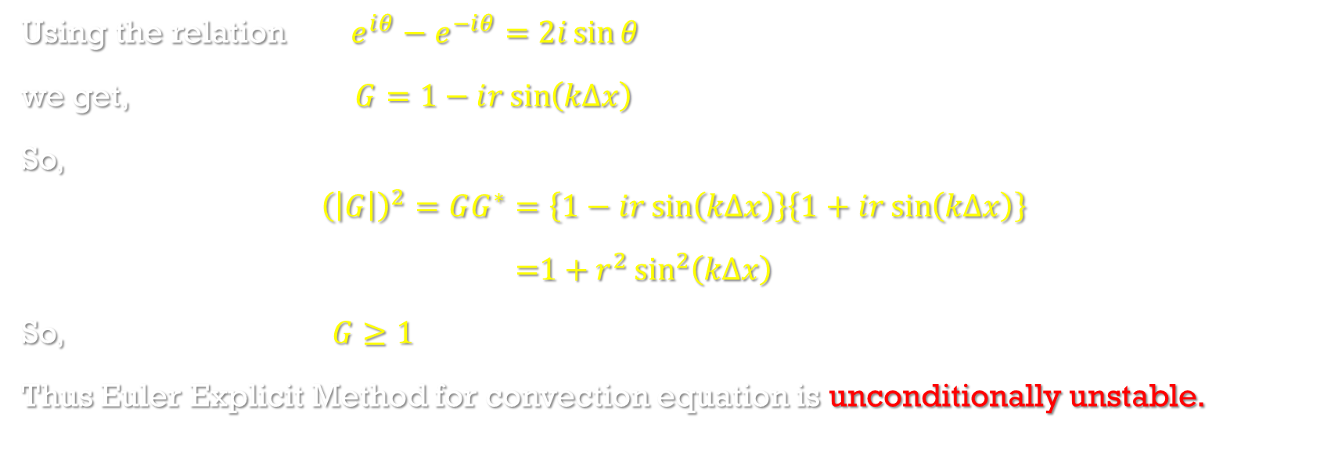
Von Neumann stability analysis of Euler explicit method(cont.)
Using the relation $ⅇ^{ⅈθ}−ⅇ^{−ⅈθ}=2ⅈ\sin{θ}$
we get, $G=1−ⅈr\sin\left(kΔx\right)$
So,
$${\left(\left|G\right|\right)}^{2}=GG^{∗}=\left\{1−ⅈr\sin\left(kΔx\right)\right\}\left\{1+ⅈr\sin\left(kΔx\right)\right\}$$
=$1+r^{2}\sin^{2}\left(kΔx\right)$
So, $G≥1$
Thus Euler Explicit Method for convection equation is unconditionally unstable.

Slide 7
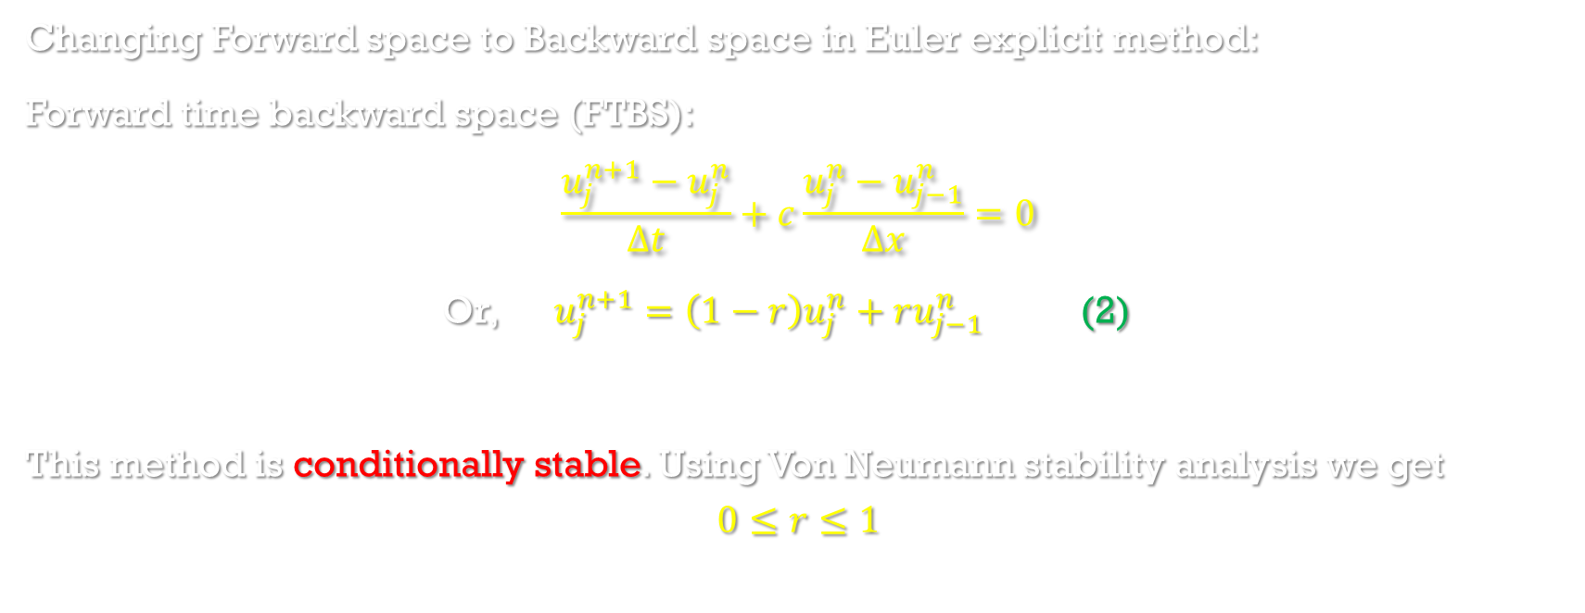
Upstream (first order upwind or windward) differencing method
Changing Forward space to Backward space in Euler explicit method:
Forward time backward space (FTBS):
$$\frac{u_{j}^{n+1}−u_{j}^{n}}{Δt}+c\frac{u_{j}^{n}−u_{j−1}^{n}}{Δx}=0$$
Or, $u_{j}^{n+1}=\left(1−r\right)u_{j}^{n}+ru_{j−1}^{n}$ (2)
This method is conditionally stable. Using Von Neumann stability analysis we get
$$0≤r≤1$$

Slide 8
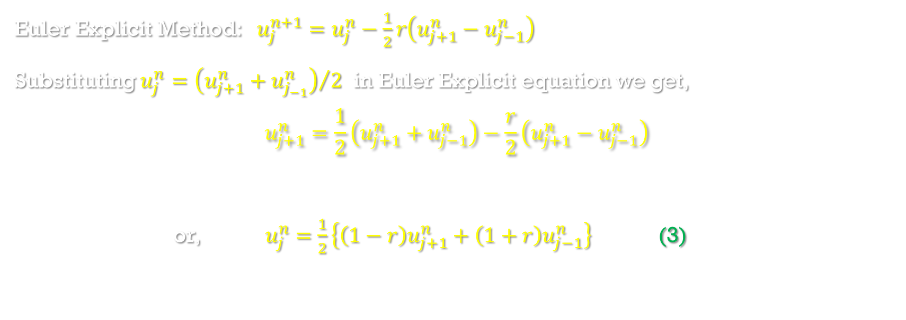
Lax method
Euler Explicit Method: $u_{j}^{n+1}=u_{j}^{n}−\frac{1}{2}r\left(u_{j+1}^{n}−u_{j−1}^{n}\right)$
Substituting $u_{j}^{n}={\left(u_{j+1}^{n}+u_{j_{−1}}^{n}\right)}/2$ in Euler Explicit equation we get,
$$u_{j+1}^{n}=\frac{1}{2}\left(u_{j+1}^{n}+u_{j−1}^{n}\right)−\frac{r}{2}\left(u_{j+1}^{n}−u_{j−1}^{n}\right)$$
or, $u_{j}^{n}$ $=$ $\frac{1}{2}\left\{\left(1−r\right)u_{j+1}^{n}+\left(1+r\right)u_{j−1}^{n}\right\}$ (3)

Slide 9
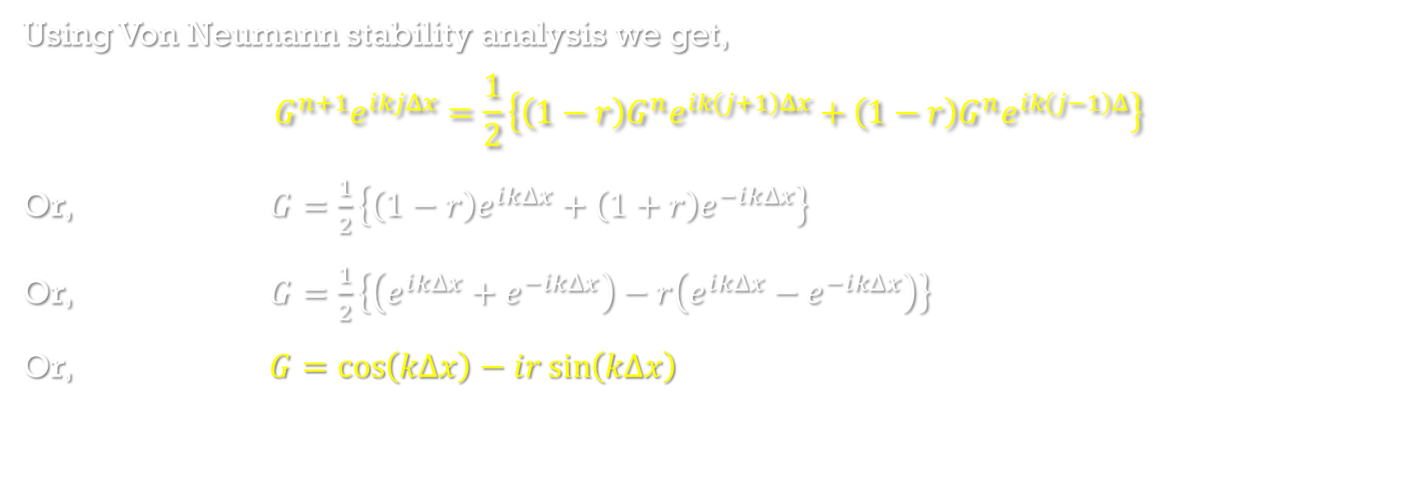
Von Neumann stability analysis of Lax method
Using Von Neumann stability analysis we get,
$$G^{n+1}ⅇ^{ⅈkjΔx}=\frac{1}{2}\left\{\left(1−r\right)G^{n}ⅇ^{ⅈk\left(j+1\right)Δx}+\left(1−r\right)G^{n}ⅇ^{ⅈk\left(j−1\right)Δ}\right\}$$
Or, $G=\frac{1}{2}\left\{\left(1−r\right)ⅇ^{ⅈkΔx}+\left(1+r\right)ⅇ^{−ⅈkΔx}\right\}$
Or, $G=\frac{1}{2}\left\{\left(ⅇ^{ⅈkΔx}+ⅇ^{−ⅈkΔx}\right)−r\left(ⅇ^{ⅈkΔx}−ⅇ^{−ⅈkΔx}\right)\right\}$
Or, $G=\cos\left(kΔx\right)−ⅈr\sin\left(kΔx\right)$

Slide 10
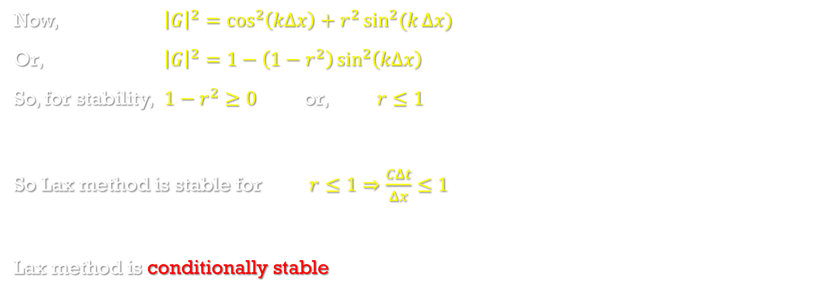
Von Neumann stability analysis of Lax method (cont.)
Now, ${\left|G\right|}^{2}=\cos^{2}\left(kΔx\right)+r^{2}\sin^{2}(k{Δx)}$
Or, ${\left|G\right|}^{2}=1−\left(1−r^{2}\right)\sin^{2}\left(kΔx\right)$
So, for stability, $1−r^{2}≥0$ or, $r≤1$
So Lax method is stable for $r≤1⇒\frac{CΔt}{Δx}≤1$
Lax method is conditionally stable

Slide 11
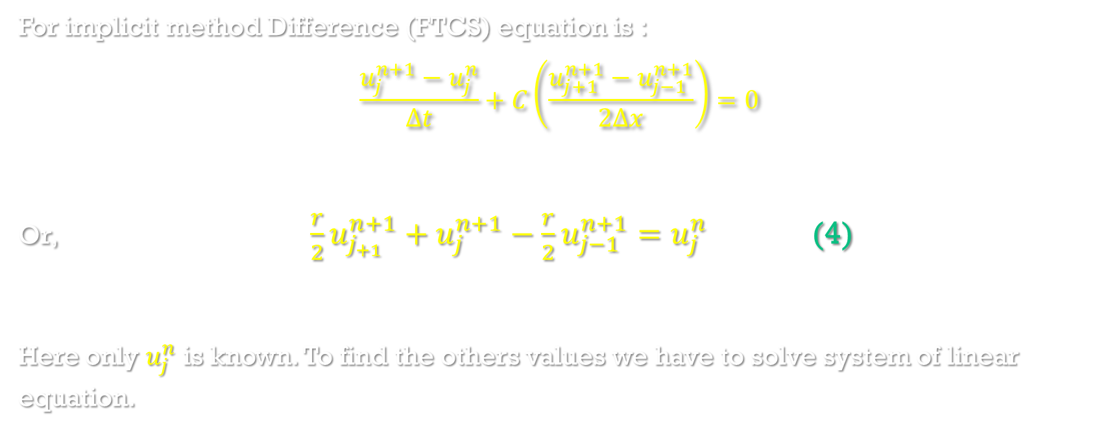
Euler implicit method
For implicit method Difference (FTCS) equation is :
$$\frac{u_{j}^{n+1}−u_{j}^{n}}{Δt}+C\left(\frac{u_{j+1}^{n+1}−u_{j−1}^{n+1}}{2Δx}\right)=0$$
Or, $\frac{r}{2}u_{j_{+1}}^{n+1}+u_{j}^{n+1}−\frac{r}{2}u_{j−1}^{n+1}=u_{j}^{n}$ (4)
Here only $u_{j}^{n}$ is known. To find the others values we have to solve system of linear equation.

Slide 12
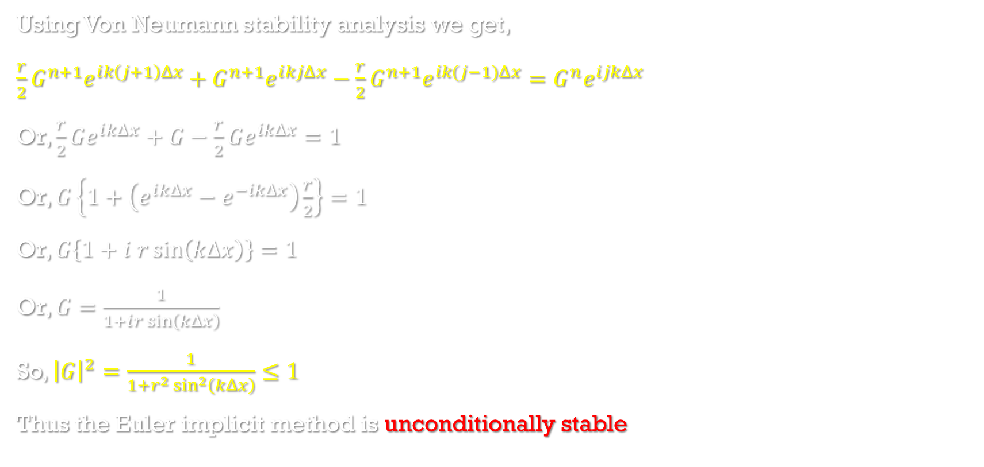
Von Neumann stability analysis of Euler implicit method
Using Von Neumann stability analysis we get,
$\frac{r}{2}G^{n+1}ⅇ^{ⅈk\left(j+1\right)Δx}+G^{n+1}ⅇ^{ⅈkjΔx}−\frac{r}{2}G^{n+1}ⅇ^{ik(j−1)Δx}=G^{n}ⅇ^{ijkΔx}$
Or, $\frac{r}{2}Gⅇ^{ⅈkΔx}+G−\frac{r}{2}Gⅇ^{ikΔx}=1$
Or, $G\left\{1+\left(ⅇ^{ⅈkΔx}−ⅇ^{−ⅈkΔx}\right)\frac{r}{2}\right\}=1$
Or, $G\left\{1+ⅈ r\sin\left(k∆x\right)\right\}=1$
Or, $G=\frac{1}{1+ⅈr\sin\left(kΔx\right)}$
So, ${\left|G\right|}^{2}=\frac{1}{1+r^{2}\sin^{2}\left(kΔx\right)}≤1$
Thus the Euler implicit method is unconditionally stable

Slide 13
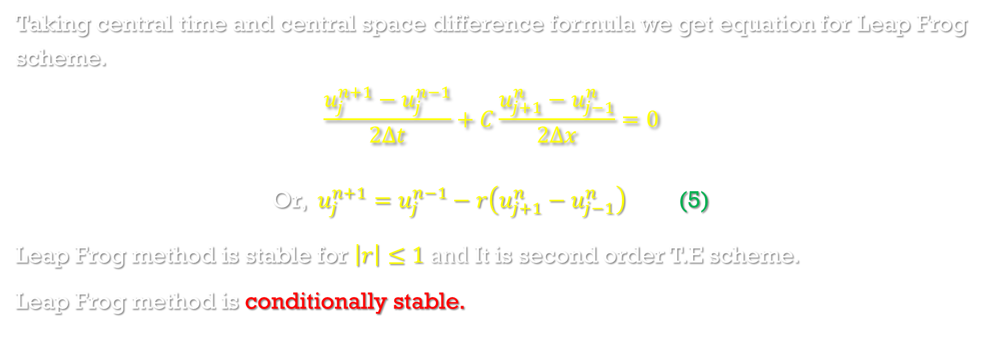
Leap frog method
Taking central time and central space difference formula we get equation for Leap Frog scheme.
$$\frac{u_{j}^{n+1}−u_{j}^{n−1}}{2Δt}+C\frac{u_{j+1}^{n}−u_{j−1}^{n}}{2Δx}=0$$
Or, $u_{j}^{n+1}=u_{j}^{n−1}−r\left(u_{j+1}^{n}−u_{j−1}^{n}\right)$ (5)
Leap Frog method is stable for $\left|r\right|≤1 and$ It is second order T.E scheme.
Leap Frog method is conditionally stable.

Slide 14
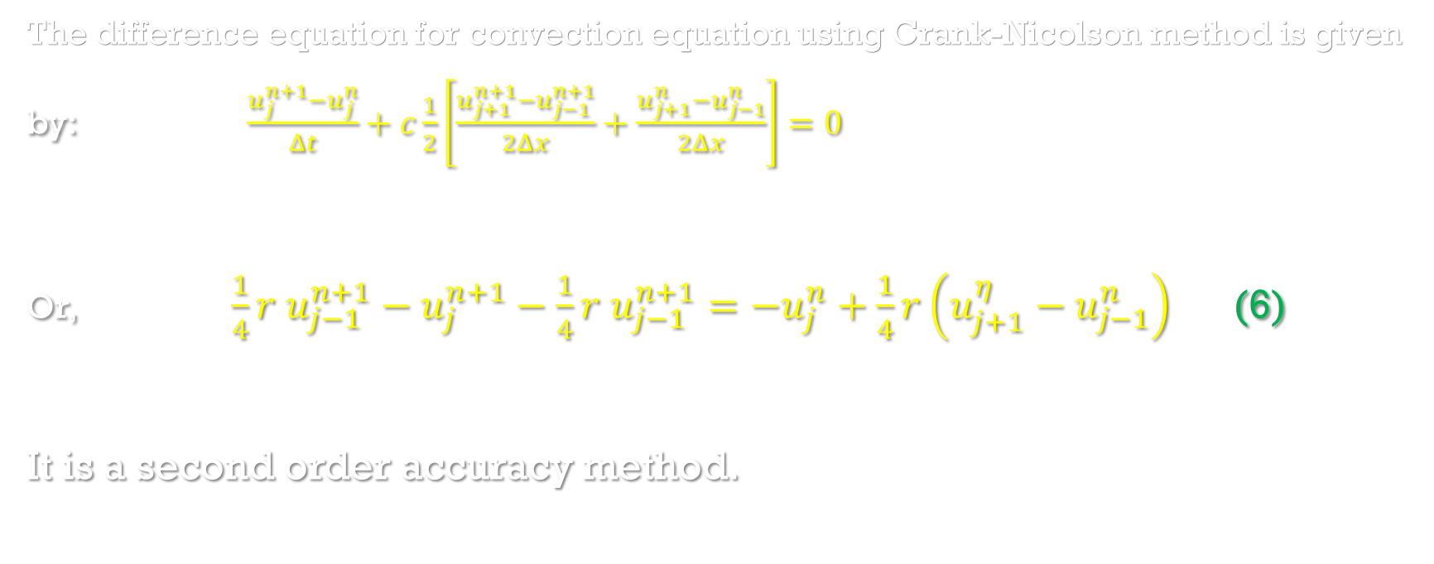
Crank-Nicolson method
The difference equation for convection equation using Crank-Nicolson method is given by: $\frac{u_{j}^{n+1}−u_{j}^{n}}{Δt}+c\frac{1}{2}\left[\frac{u_{j+1}^{n+1}−u_{j−1}^{n+1}}{2Δx}+\frac{u_{j+1}^{n}−u_{j−1}^{n}}{2Δx}\right]=0$
Or, $\frac{1}{4}r{ u}_{j−1}^{n+1}−u_{j}^{n+1}−\frac{1}{4}r{ u}_{j−1}^{n+1}=−u_{j}^{n}+\frac{1}{4}r\left(u_{j+1}^{η}−u_{j−1}^{n}\right)$ (6)
It is a second order accuracy method.

Slide 15
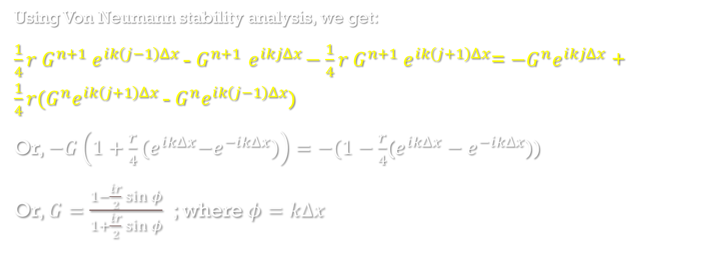
Von neumann stability analysis Crank-Nicolson method
Using Von Neumann stability analysis, we get:
$\frac{1}{4}r G^{n+1}{ ⅇ}^{ⅈk\left(j−1\right)Δx }$- $G^{n+1}{ ⅇ}^{ⅈkjΔx}−\frac{1}{4}r{ G}^{n+1}{ ⅇ}^{ⅈk\left(j+1\right)Δx}$= ${−G}^{n}ⅇ^{ⅈkjΔx}$ + $\frac{1}{4}r{(G}^{n}ⅇ^{ⅈk\left(j+1\right)Δx }$-${ G}^{n}ⅇ^{ⅈk\left(j−1\right)Δx}$)
Or, $−G\left(1+\frac{r}{4}{(ⅇ}^{ⅈkΔx}−ⅇ^{−ⅈkΔx})\right)=−(1−\frac{r}{4}$($ⅇ^{ⅈkΔx}−ⅇ^{−ⅈkΔx}$))
Or, $G=\frac{1−\frac{ⅈr}{2}\sin{φ}}{1+\frac{ⅈr}{2}\sin{φ}}$ ; where $φ=kΔx$

Slide 16
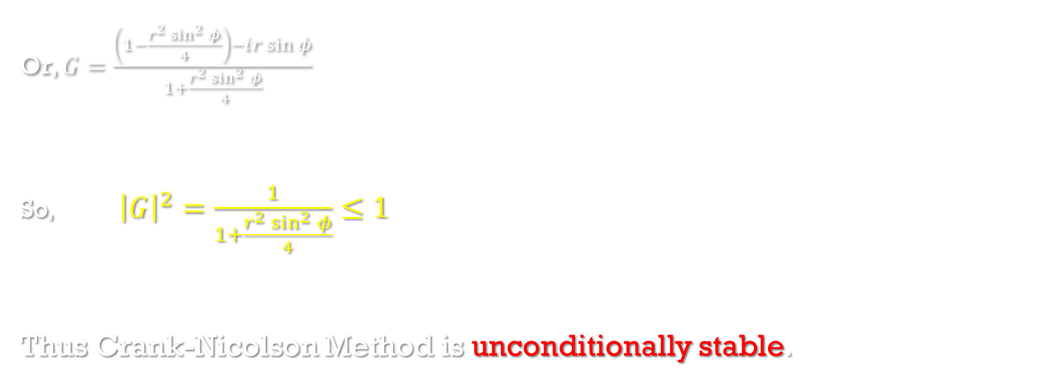
Von neumann stability analysis for Crank-Nicolson method(cont.)
Or, $G=\frac{\left(1−\frac{r^{2}\sin^{2}{φ}}{4}\right)−ⅈr\sin{φ}}{1+\frac{r^{2}\sin^{2}{φ}}{4}}$
So, ${\left|G\right|}^{2}=\frac{1}{1+\frac{r^{2}\sin^{2}{φ}}{4}}≤1$
Thus Crank-Nicolson Method is unconditionally stable.

Slide 17
Reference
Computational Fluid Dynamics and Heat Transfer by John C. Tannehill, Dale A. Anderson, Richard H. Pletcher
Computational Fluid Dynamics Volume I by Klaus A. Hoffmann, Steve T. Chiang

Slide 18
Thank You

